Slide 1


Hazardous Asteroid prediction using Machine Learning
By Salonee Jadhav

Slide 2
Table of contents
01
02
03
04
05
06
Introduction to data
Preprocessing the Data & EDA
Feature Engineering & Model selection ,
Training the Model
Evaluation
Conclusions

Slide 3


01
Introduction to the dataset
Near-Earth objects are asteroids and comets with orbits that bring them to within 120 million miles (195 million kilometers) of the Sun, which means they can circulate through the Earth’s orbital neighborhood.
As more observations are made, accuracy of an object's orbit improves and it becomes possible to predict where an object could hit the earth or not.

Slide 4
This dataset has various information about the NEOs like:
NEO ID : A unique ID given by NASA to all NEO, same as the ID
Name : Official name given by NASA
Designation : The number used in the official name given by NASA
Absolute Magnitude : Absolute magnitude (M) is a measure of the luminosity of a celestial object
The minimum and the maximum estimated diameter in kilometers
Orbit ID : A unique ID for the orbit of the object
Orbit Class : Classification of the object orbit into classes
Perihelion Distance : The point at which the body is closest to the sun
Aphelion Distance : The point at which the body is furthest from the sun
First and last observation date of the object

Slide 5

Preprocessing and EDA

Slide 6
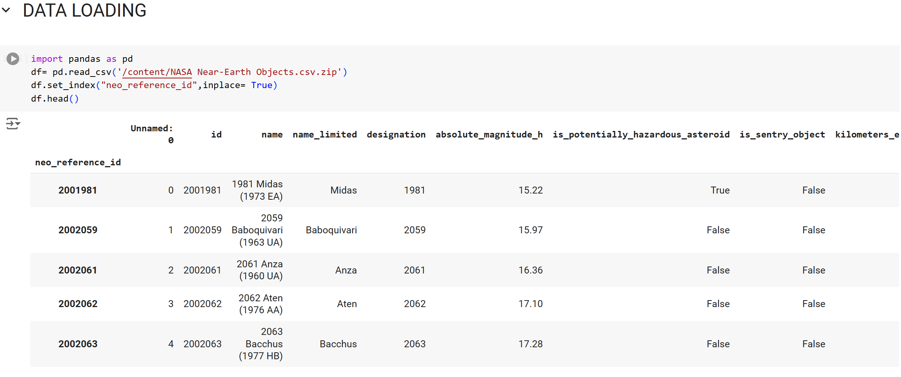
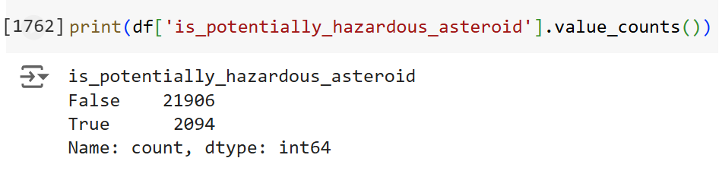

Slide 7
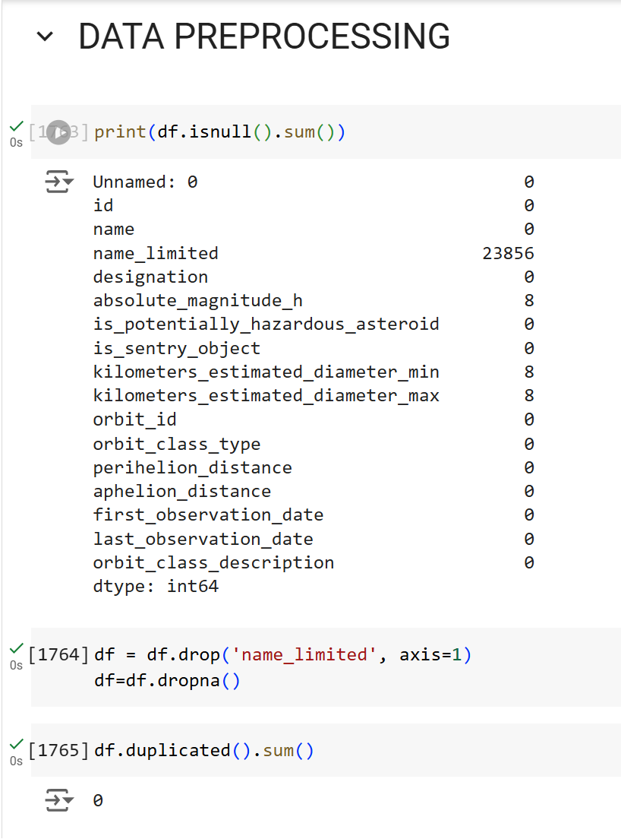
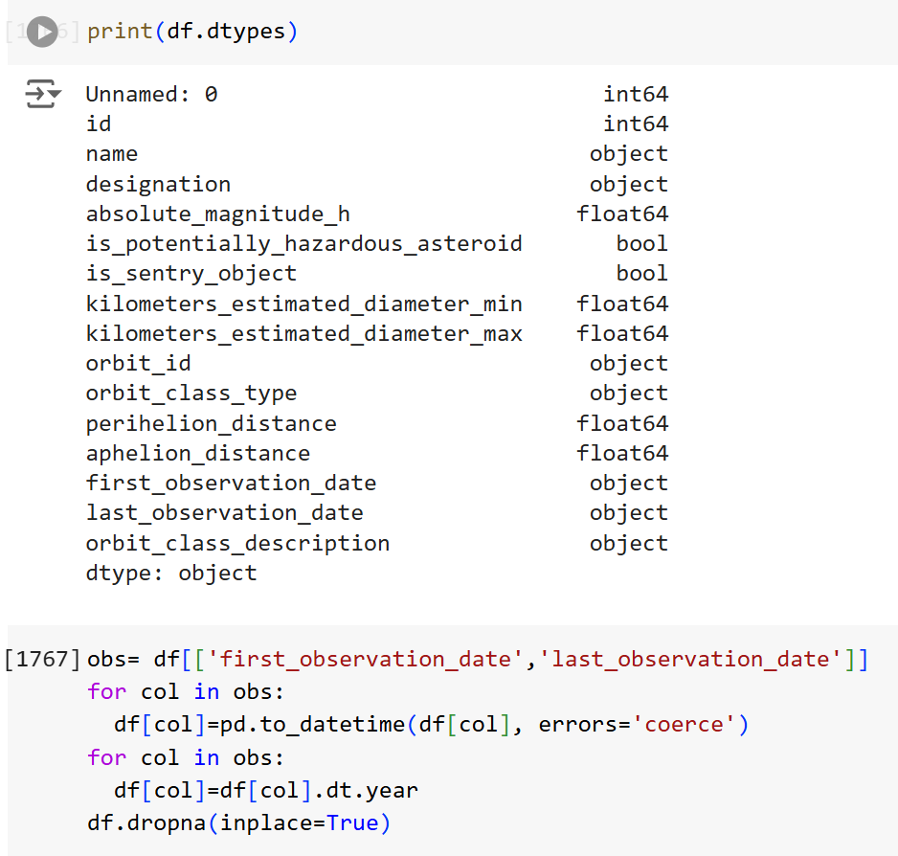

Slide 8
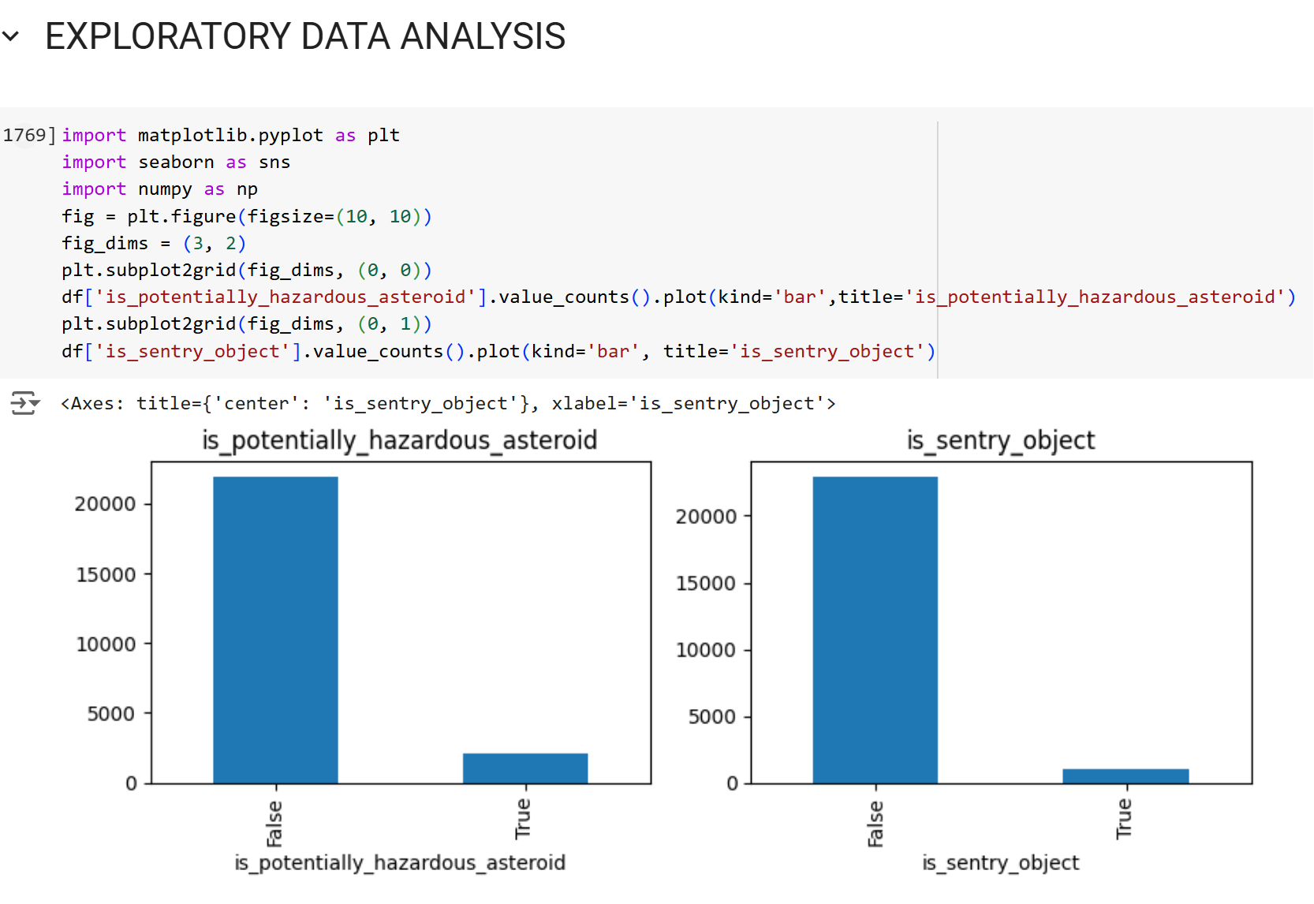
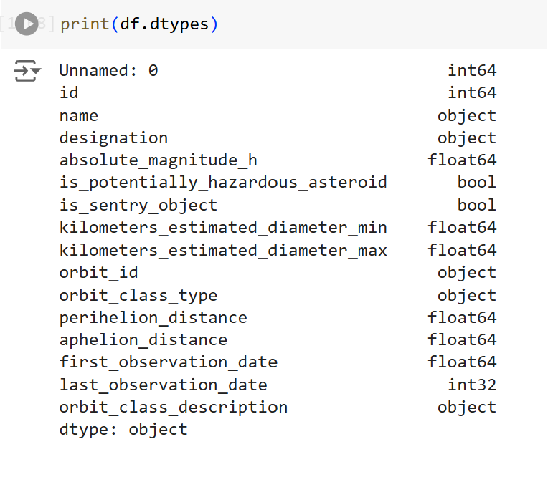
To check value counts for hazardous and sentry objects

Slide 9
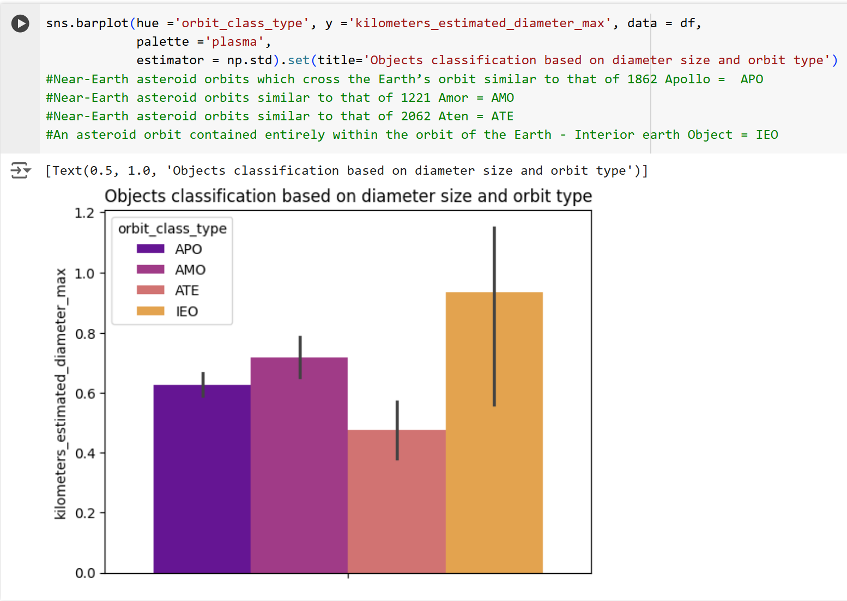
The biggest observed object till 2020 belongs to which orbit type

Slide 10
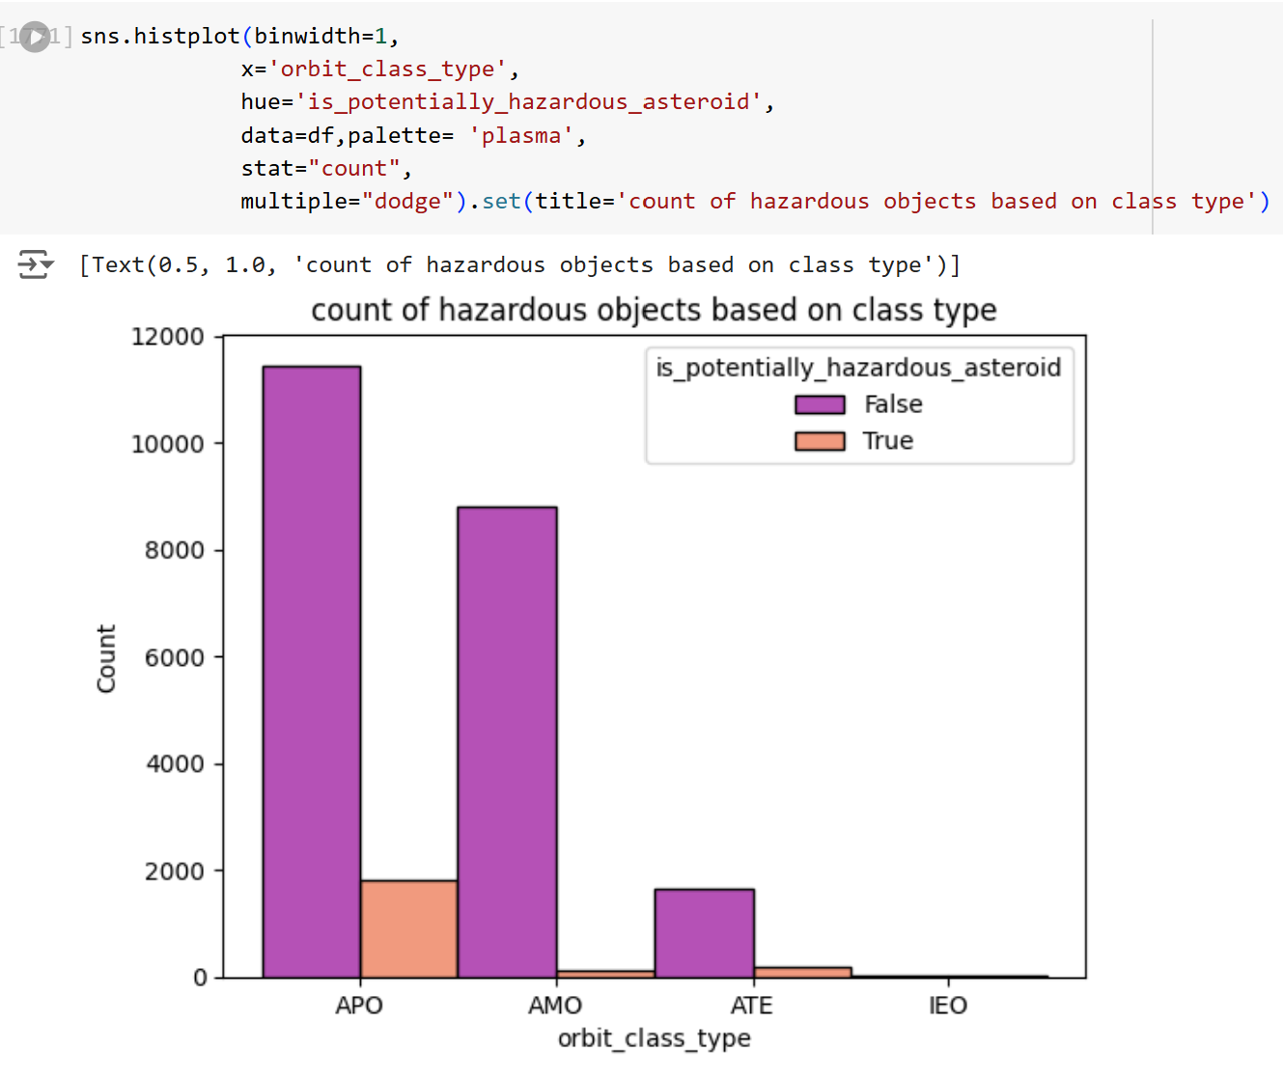
Count of hazardous objects based on orbit type

Slide 11
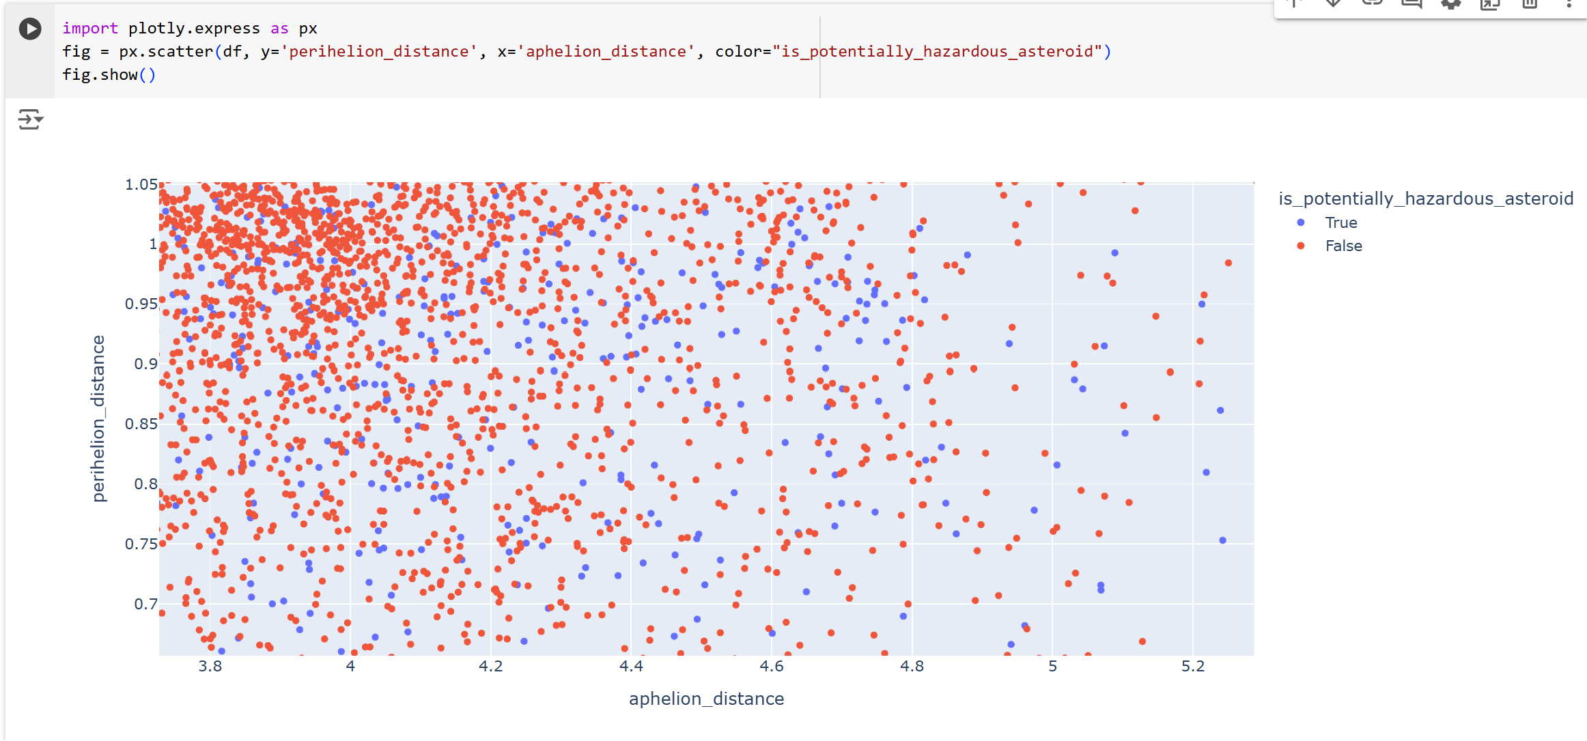
Relationship between perihelion & aphelion distance vs whether the object hazardous or not.

Slide 12
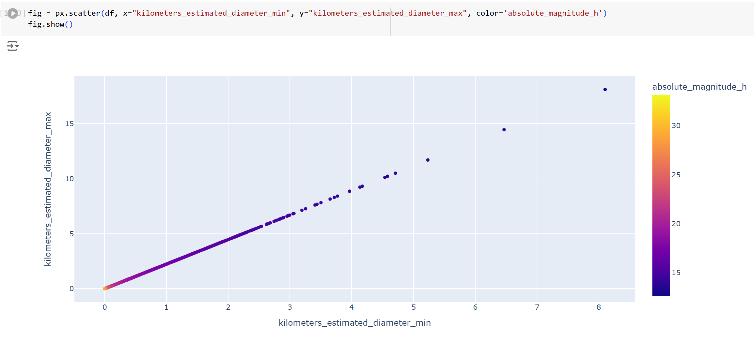
Relationship between diameter of object and absolute magnitude

Slide 13
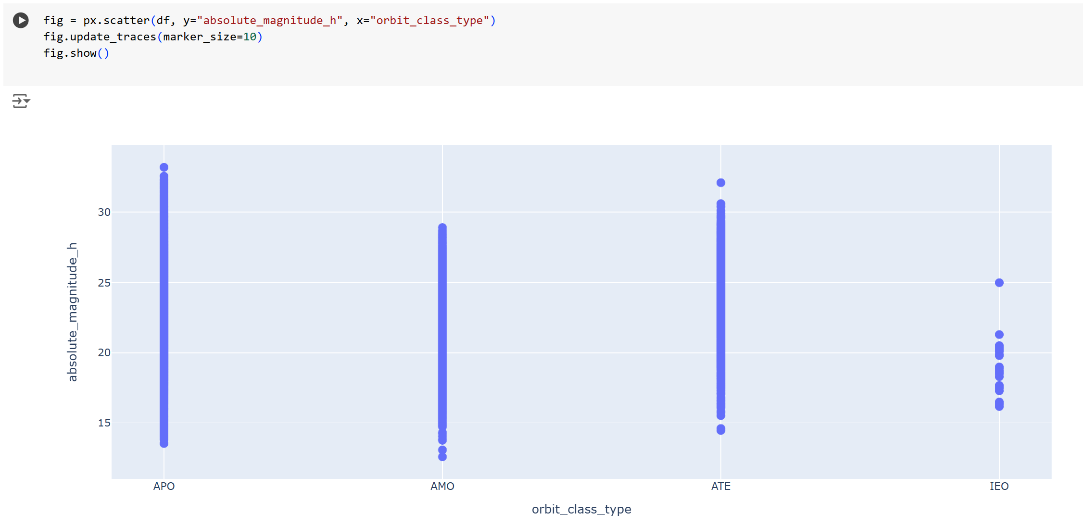
Relationship between magnitude and orbit type
Years in which most observations happened

Slide 14
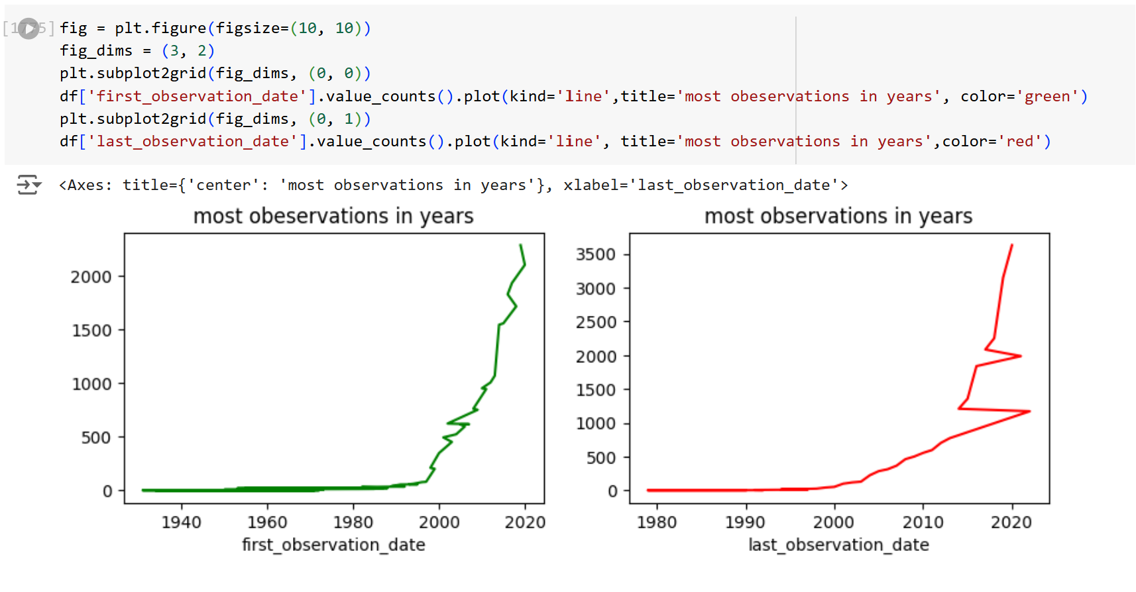
Years in which most observations happened

Slide 15
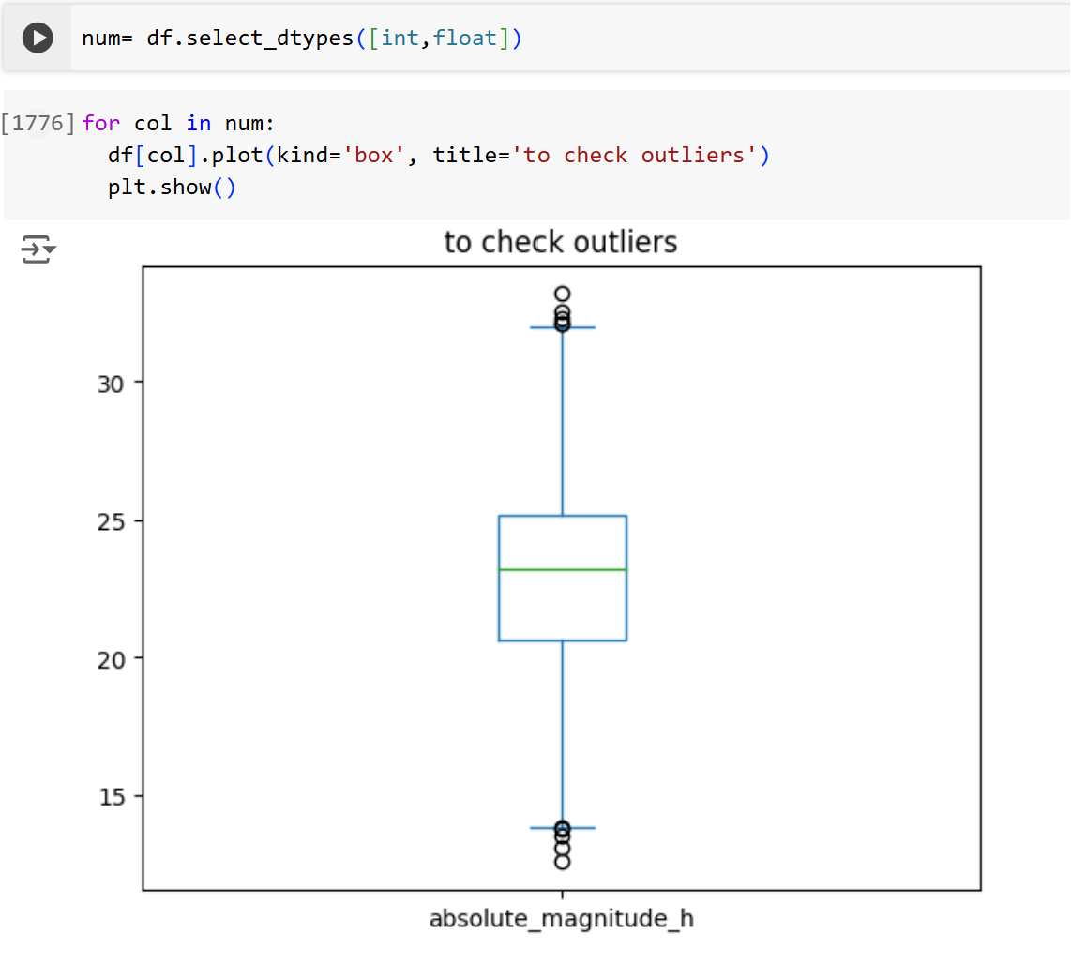
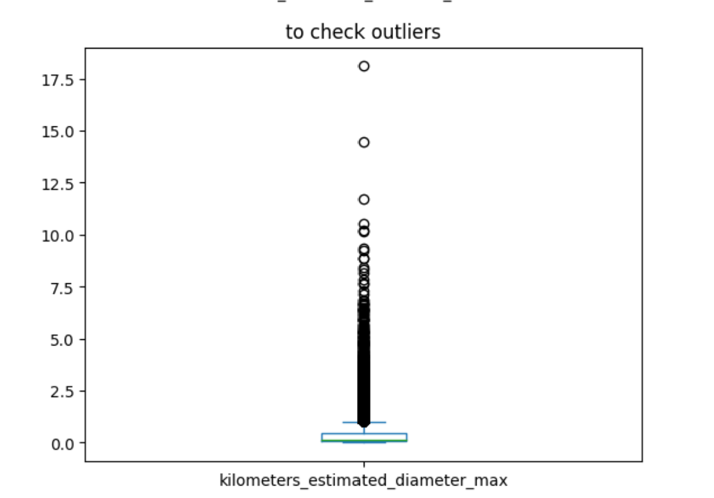

Slide 16
Feature Engineering &Training the Model

Slide 17
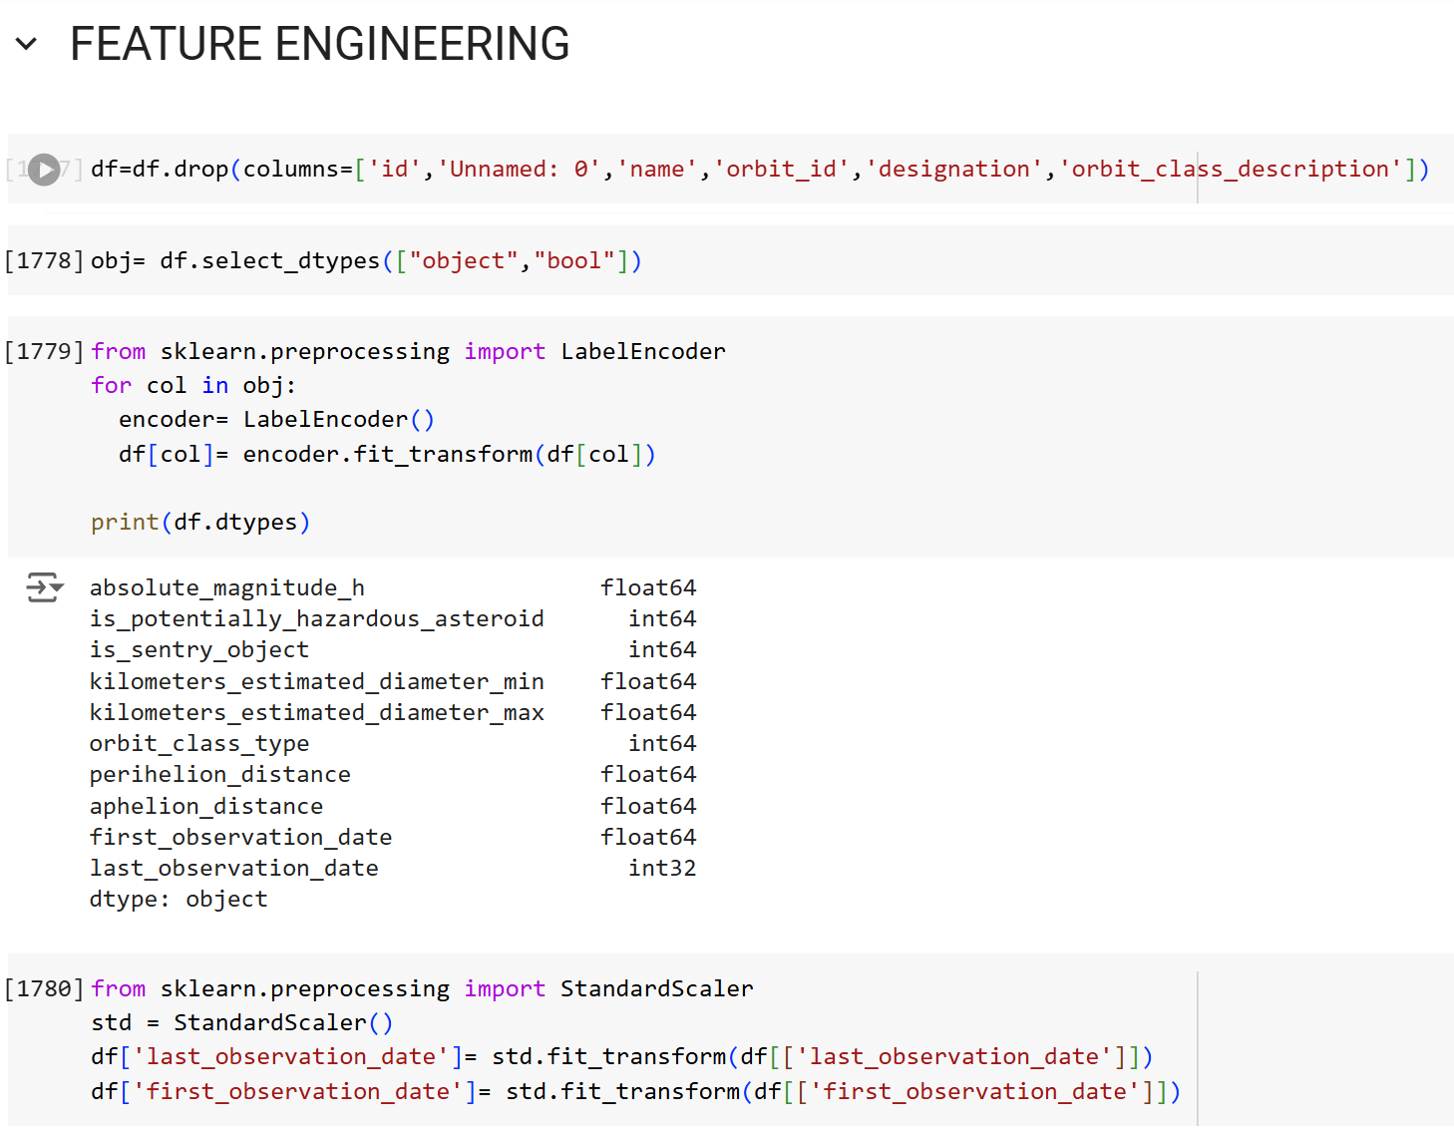
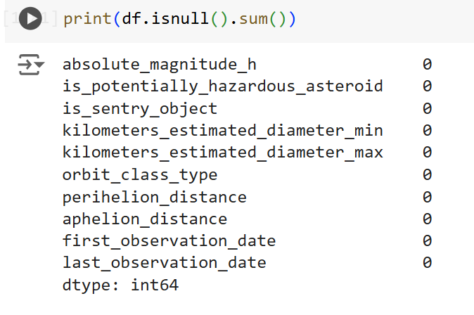

Slide 18
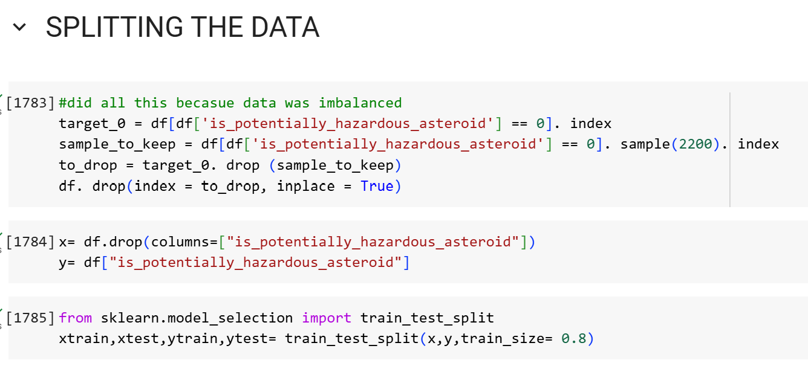
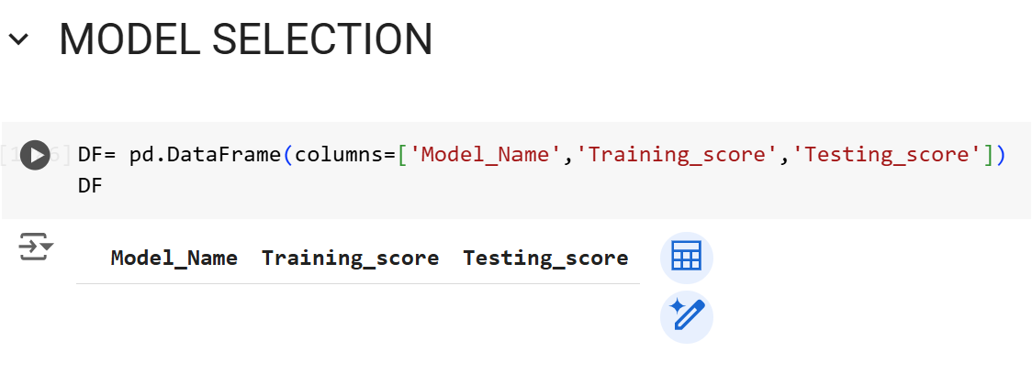

Slide 19
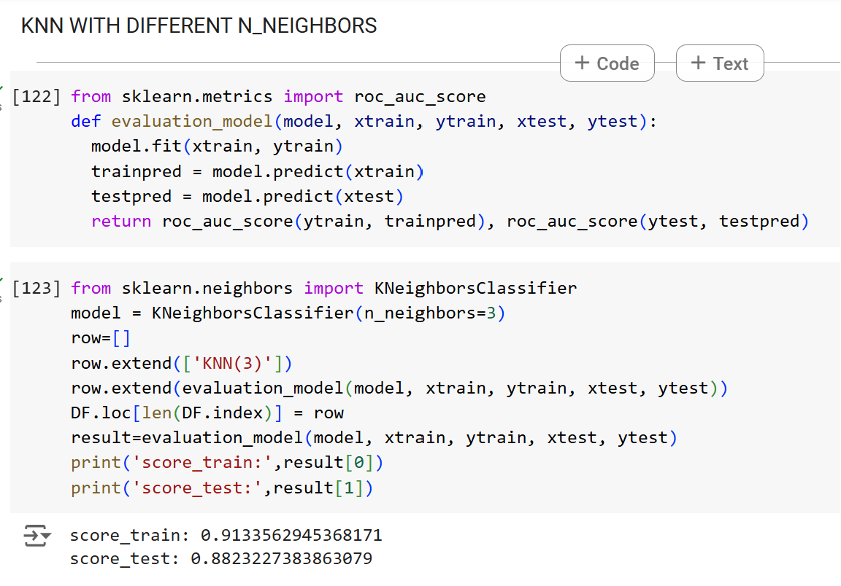
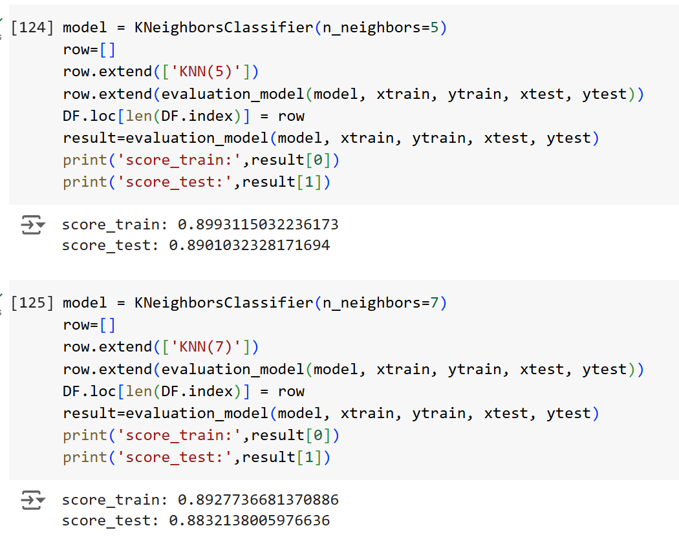

Slide 20
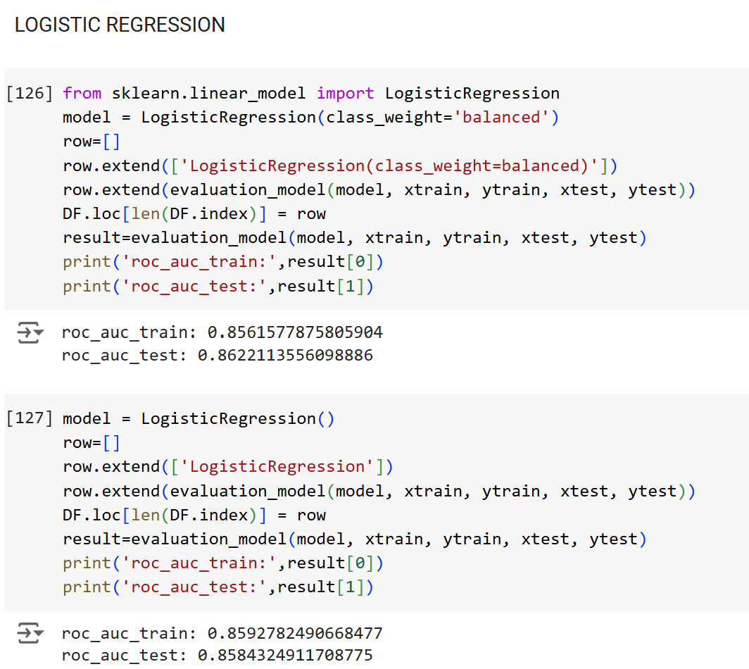

Slide 21
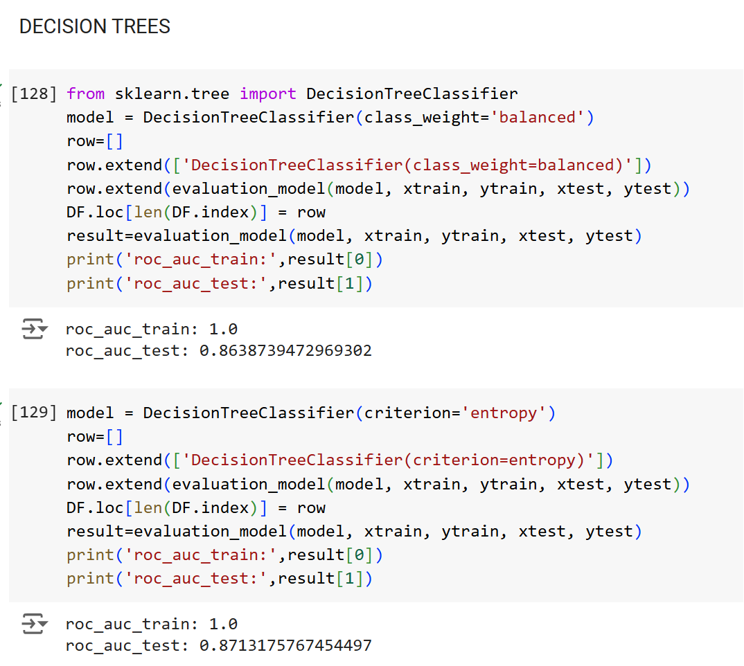
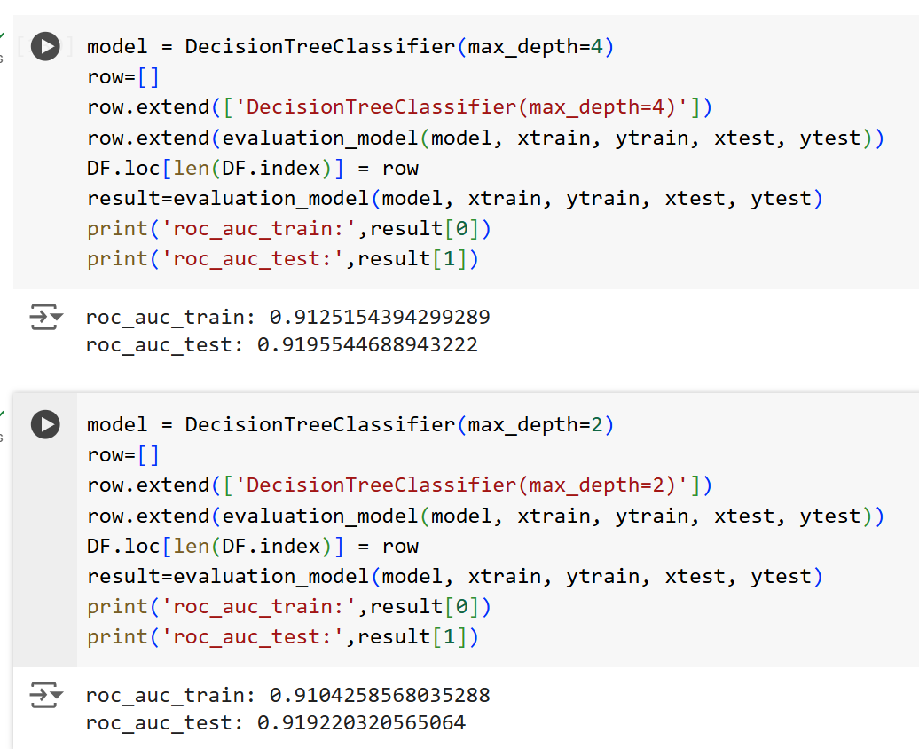

Slide 22
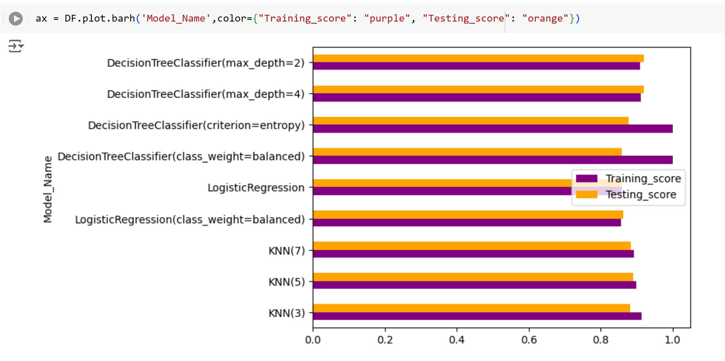
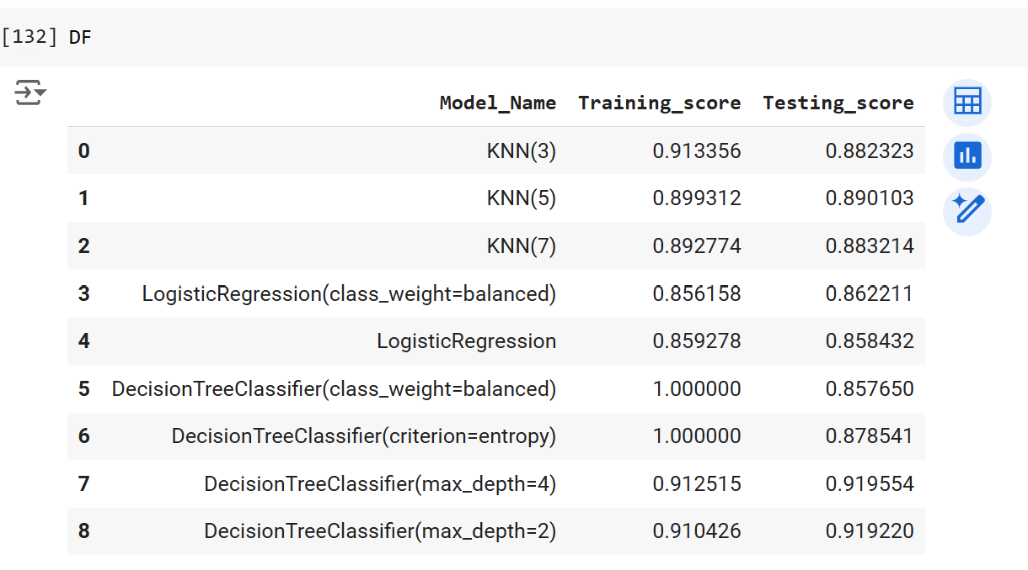

Slide 23
TRAINING THE DATA WITH SELECTED MODEL

Slide 24
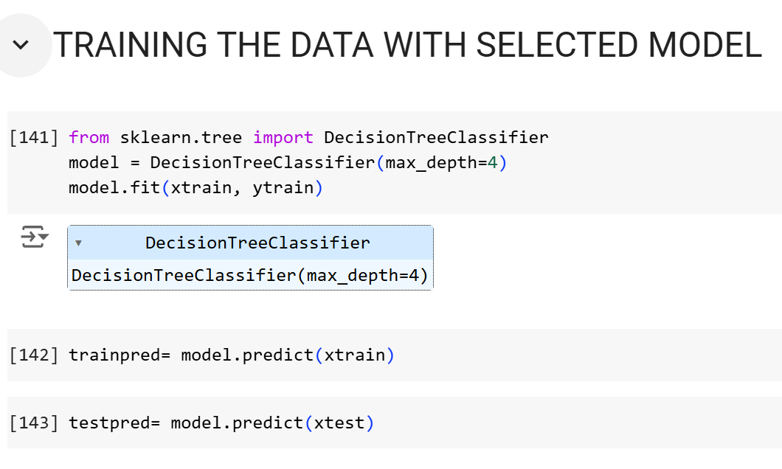

Slide 25
Evaluation

Slide 26
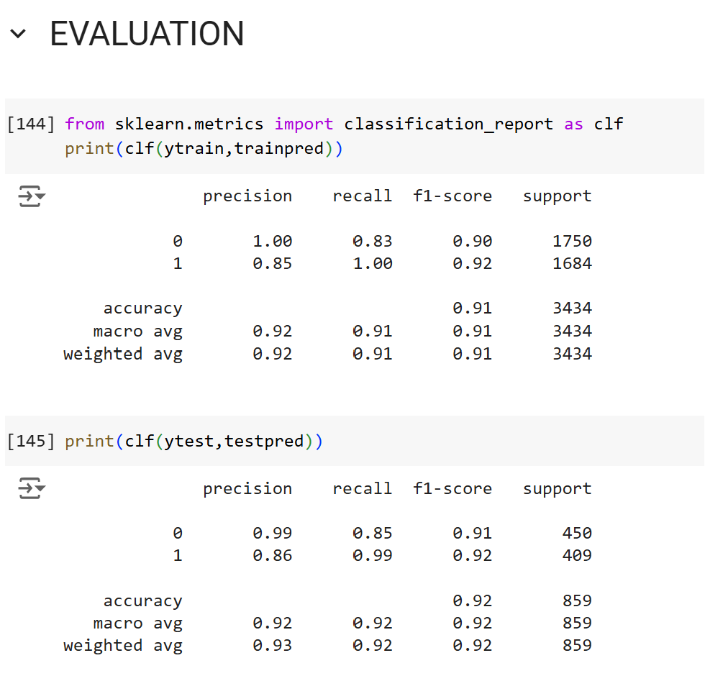
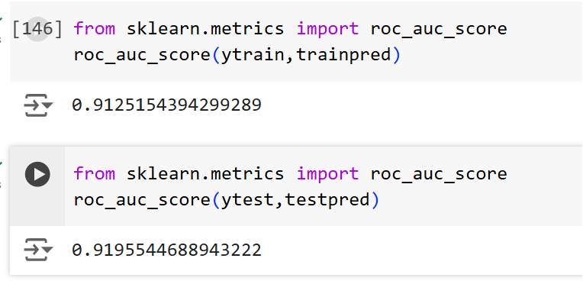

Slide 27
Conclusions:
The data was imbalanced.
Most NEO ( near earth objects ) belonged to the orbit type IEO
Most Hazardous objects were found in orbit type APO
As diameter or the size of NEO increases the absolute magnitude decreases i:e; the lower the magnitude number, the brighter the object ( in this case reflection)
The most bright NEO’s are in AMO orbit type where as least bright NEO’s are in APO orbit type.
The data had outliers and carried important information hence used decision tree classifier as it works well with outliers.
The decision tree classifier with maximum depth=4 model gave more than 91% accuracy for both test and train data.

Slide 28

Thank you
Happy coding ☺

